Slide 1
BRAIN TUMOR IMAGE CLASSIFICATION USING CONVOLUTIONAL NEURAL NETWORKS By Batch 333 (Section - 3)
Guide: Dr. Chayan Paul
Emp. No.: 5212
180030193 – Vatrapu Sri Lekha Reddy
180030200 – Sarigala Shainy
180031128 – Bolla Lahya
180031177 – Uppala Bhuvana Priya

Slide 2
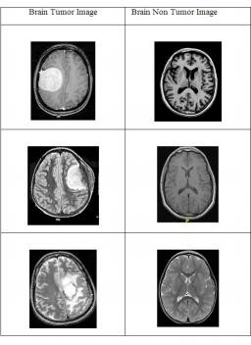
CNN based classified results

Slide 3
The brain tumors, are the most widely recognized and forceful sickness, prompting a short future in their most elevated evaluation. For the most part, different picture procedures, for example, Computed Tomography (CT), Magnetic Resonance Imaging (MRI)and ultrasound picture are utilized to assess the tumor in a mind, lung, Especially, right now pictures are utilized to analyze tumor in the mind.
Here, tumor location is identified by utilizing Convolutional Neural Networks (CNN) arrangement. It was performed on a continuous dataset having pictures with changed tumor factors, for example, picture power, shape and size. The point of this project is to classify the X-ray pictures into benevolent and harmful cerebrum tissues.

Slide 4
Problem Statement
The cerebrum tumor discovery is testing task in enormous spatial and auxiliary changeability of encompassing district of mind tumor. Here, tumor location is identified by utilizing Convolutional Neural Networks (CNN) arrangement. It was performed on a continuous dataset having pictures with changed tumor factors, for example, picture power, shape and size. The point of this project is to classify the X-ray pictures into benevolent and harmful cerebrum tissues.

Slide 5
Objective
The objective of this project is to reduce the errors and difficulty in manual classification of brain tumor images by using Deep learning techniques. Convolutional Neural Networks has been used for feature extraction and image classification.
The main advantage of CNN is that it automatically detects the important features without any human supervision. This is why CNN would be an ideal solution to computer vision and image classification problems.

Slide 6
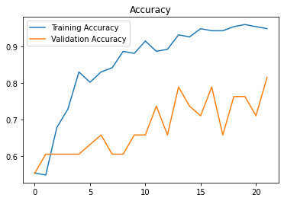
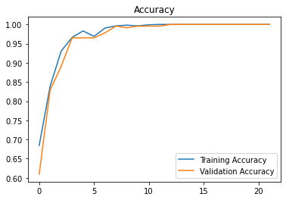
Existing System
Proposed System

Slide 7
Proposed System
The human brain is modeled by using the design and implementation of neural networks. The convolution neural network is employed for brain tumor detection. The brain image dataset is taken from the Kaggle repository is one of the pre-trained models. In the convolution layer, the given input image is segregated into various small regions. Element wise activation function is carried out in ReLU layer and the pooling layer is used for down sampling. In the final layer fully, the connected layer is used to generate the class score. In the proposed CNN, we will train the last layer in python implementation. We don’t want to train all the layers. So, computation time is less meanwhile the performance is high within the proposed brain tumor detection scheme.

Slide 8
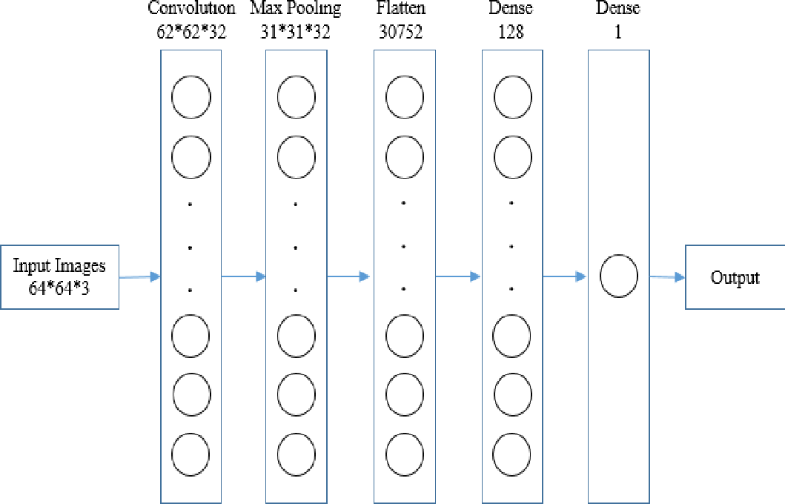
Convolution Neural Network

Slide 9
Convolution
Convolution is the first layer to extract features from an input image . It summarizes the presence of features in an input image.
It preserves the relationship between pixels by learning image features using small squares of input data. It is a mathematical operation that takes two inputs such as image matrix and a filter.

Slide 10
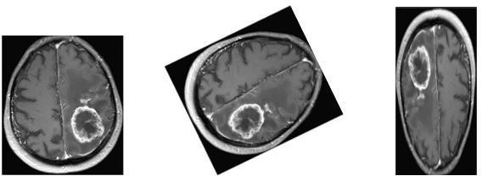
Max Pooling
A pooling layer is a new layer added after the convolutional layer.
Max pooling is a pooling operation that selects the maximum element from the region of the feature map covered by the filter. Thus, the output after max-pooling layer would be a feature map containing the most prominent features of the previous feature map.

Slide 11
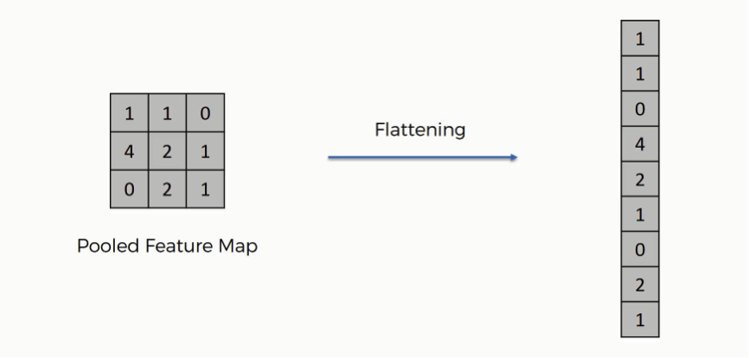
Flattening layer:
In this layer we flatten the pooled feature map into a column.
Flattening is converting the data into a 1-dimensional array for inputting it to the next layer. We flatten the output of the convolutional layers to create a single long feature vector. And it is connected to the final classification model, which is called a fully-connected layer.

Slide 12
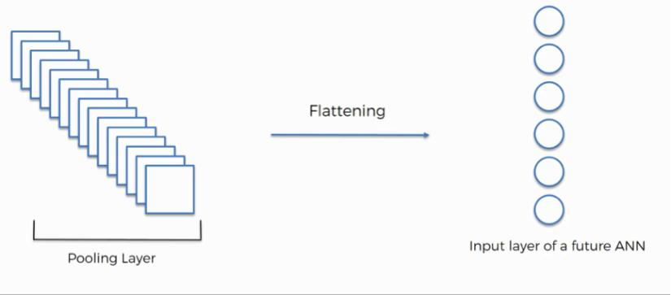
Fully connection-1 (ReLU Activation):
Fully Connected Layers form the last few layers in the network. The input to the fully connected layer is the output from the final Pooling Layer, which is flattened and then fed into the fully connected layer.
Here ReLU( Rectified Linear Unit) Activation is done which helps to prevent the exponential growth in the computation required to operate the neural network.

Slide 13
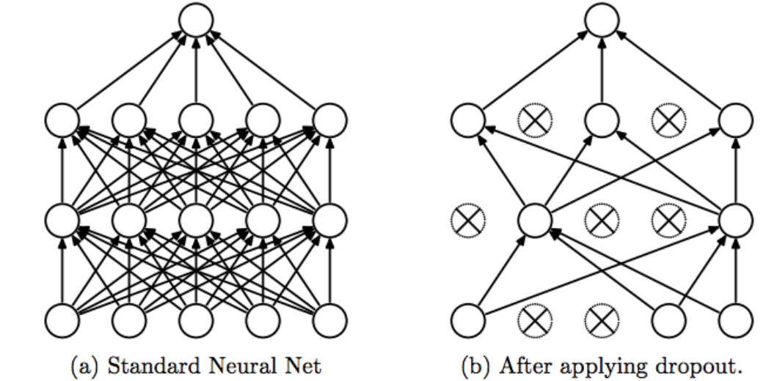
Dropout Layer
Dropout refers to ignoring units (i.e. neurons) during the training phase of certain set of neurons which is chosen at random. By “ignoring”, I mean these units are not considered during a particular forward or backward pass.

Slide 14
Fully Connection-2 (Sigmoid Activation):
Sigmoid Function acts as an activation function which decides which value to pass as output and what not to pass.
The main reason why we use sigmoid function is because it exists between (0 to 1). Therefore, it is especially used for models where we have to predict the probability as an output.
Since probability of anything exists only between the range of 0 and 1, sigmoid is the right choice.

Slide 15
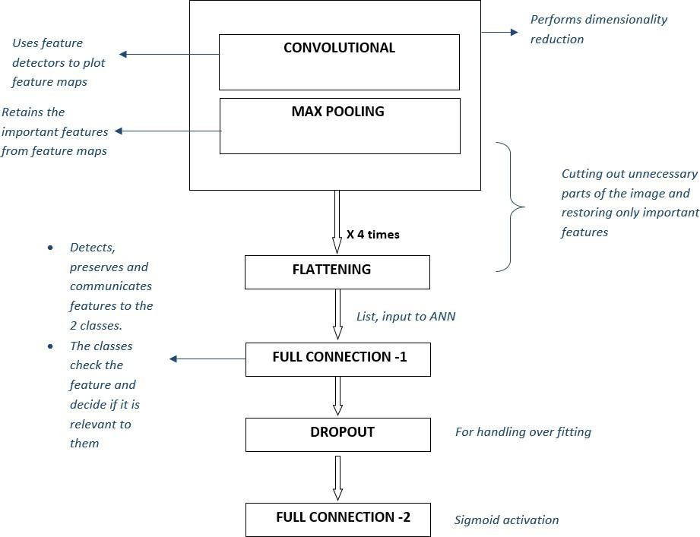

Slide 16
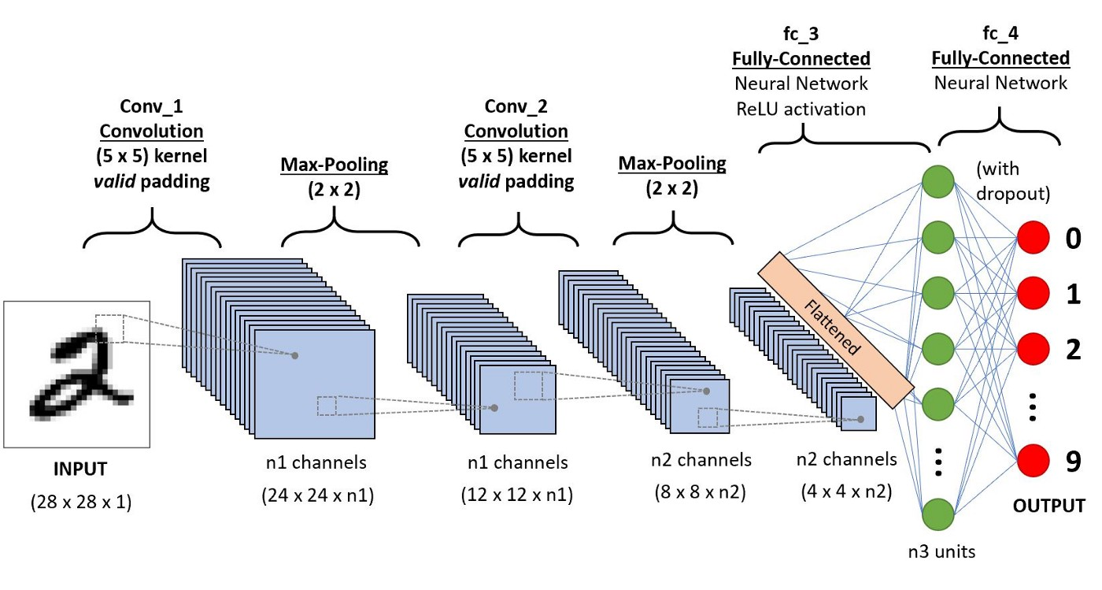

Slide 17
Implementation
!pip install imutils
import numpy as np
import pandas as pd
import os
from os import listdir
import tensorflow as tf
from keras.preprocessing.image import ImageDataGenerator
import matplotlib.pyplot as plt
%matplotlib inline
import numpy as np

Slide 18
import sys
pip install opencv-python
import cv2
import imutils
import itertools
from sklearn.metrics import accuracy_score,confusion_matrix
from tensorflow.keras.models import Model,load_model
from tensorflow.keras.layers import
Conv2D,Input,ZeroPadding2D,BatchNormalization,Flatten,Activation,Dense,MaxPooling2D
from sklearn.model_selection import train_test_split
from sklearn.utils import shuffle

Slide 19
images="C:\\Users\\Lenovo\\Desktop\\Project\\Data"
os.makedirs('C:\\Users\\Lenovo\\Desktop\\Project\\Output')
os.makedirs('C:\\Users\\Lenovo\\Desktop\\Project\\Output\\Yes')
os.makedirs('C:\\Users\\Lenovo\\Desktop\\Project\\Output\\No')
def augment_data(file_dir,n_generated_samples,save_to_dir):
data_gen=ImageDataGenerator(rotation_range=10,width_shift_range=0.1,height_shift_range=0.1,shear_range=0.1, brightness_range=(0.3,1.0),horizontal_flip=True,vertical_flip=True,fill_mode='nearest')
for filename in listdir(file_dir):
image=cv2.imread(file_dir+'/'+filename)
image=image.reshape((1,)+image.shape)
save_prefix='aug_'+filename[:-4]
i=0
for batch in data_gen.flow(x=image,batch_size=1,save_to_dir=save_to_dir,save_prefix=save_prefix,save_format='jpg'):
i+=1
if i>n_generated_samples:
break

Slide 20
def crop_brain_contour(image,plot=False):
gray=cv2.cvtColor(image,cv2.COLOR_BGR2GRAY)
gray=cv2.GaussianBlur(gray,(5,5),0)
thresh=cv2.threshold(gray,45,255,cv2.THRESH_BINARY)[1]
thresh=cv2.erode(thresh,None,iterations=2)
thresh=cv2.dilate(thresh,None,iterations=2)
cnts=cv2.findContours(thresh.copy(),cv2.RETR_EXTERNAL,cv2.CHAIN_APPROX_SIMPLE)
cnts=imutils.grab_contours(cnts)
c=max(cnts,key=cv2.contourArea)
extLeft=tuple(c[c[:, :, 0].argmin()][0])
extRight=tuple(c[c[:, :, 0].argmax()][0])
extTop=tuple(c[c[:, :, 1].argmin()][0])
extBot=tuple(c[c[:, :, 1].argmax()][0])
new_image=image[extTop[1]:extBot[1], extLeft[0]:extRight[0]]
if plot:
plt.figure()
plt.subplot(1, 2, 1)
plt.imshow(image)

Slide 21
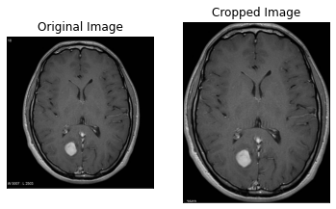

Slide 22
plt.tick_params(axis='both',which='both',top=False,bottom=False,left=False,right=False,labelbottom=False,labeltop=False, labelleft=False,labelright=False)
plt.title('Original Image')
plt.subplot(1, 2, 2)
plt.imshow(new_image)
plt.tick_params(axis='both',which='both',top=False,bottom=False,left=False,right=False,labelbottom=False,labeltop=False, labelleft=False,labelright=False)
plt.title('Cropped Image')
plt.show()
return new_image
ex_img=cv2.imread('C:\\Users\\Lenovo\\Desktop\\Project\\Data\\yes\\Y6.jpg')
ex_crop_img=crop_brain_contour(ex_img,True)

Slide 23
def load_data(dir_list,image_size):
X=[]
Y=[]
image_width,image_height=image_size
for directory in dir_list:
for filename in listdir(directory):
image=cv2.imread(directory+'/'+filename)
image=crop_brain_contour(image,plot=False)
image=cv2.resize(image, dsize=(image_width,image_height),interpolation=cv2.INTER_CUBIC)
image=image/255.
X.append(image)
if directory[-3:]=='yes':
Y.append([1])
else:
Y.append([0])
X=np.array(X)
Y=np.array(Y)
X,Y=shuffle(X,Y)
print(f'Number of examples is: {len(X)}')
print(f'X shape is: {X.shape}')
print(f'Y shape is: {Y.shape}')
return X,Y

Slide 24
augmented_yes=augmented_data_path+'yes'
augmented_no=augmented_data_path+'no'
IMG_WIDTH,IMG_HEIGHT=(240,240)
X,Y=load_data([augmented_yes,augmented_no],(IMG_WIDTH,IMG_HEIGHT))
def plot_sample_images(X,Y,n=50):
for label in [0,1]:
images=X[np.argwhere(Y==label)]
n_images=images[:n]
columns_n=10
rows_n=int(n/columns_n)
plt.figure(figsize=(10,8))
i=1
for image in n_images:
plt.subplot(rows_n,columns_n,i)
plt.imshow(image[0])
plt.tick_params(axis='both',which='both',top=False, bottom=False,left=False,right=False,labelbottom=False, labeltop=False,labelleft=False,labelright=False)
i += 1
label_to_str=lambda label: "Yes" if label==1 else "No"
plt.suptitle(f"Brain Tumor: {label_to_str(label)}")
plt.show()

Slide 25
plot_sample_images(X,Y)
def split_data(X,Y,test_size=0.2):
X_train,X_test_val,Y_train,Y_test_val=train_test_split(X,Y,test_size=test_size)
X_test,X_val,Y_test,Y_val=train_test_split(X_test_val,Y_test_val,test_size=0.5)
return X_train,Y_train,X_val,Y_val,X_test,Y_test
X_train,Y_train,X_val,Y_val,X_test,Y_test=split_data(X,Y,test_size=0.3)
print("number of training examples = "+str(X_train.shape[0]))
print("number of validation examples = "+str(X_val.shape[0]))
print("number of test examples = "+str(X_test.shape[0]))
def build_model(input_shape):
X_input=Input(input_shape)
X=ZeroPadding2D((2, 2))(X_input)
X=Conv2D(32,(7,7),strides=(1,1))(X)
X=BatchNormalization(axis=3,name='bn0')(X)
X=Activation('relu')(X)
X=MaxPooling2D((4,4))(X)
X=MaxPooling2D((4,4))(X)

Slide 26
X=Flatten()(X)
X=Dense(1,activation='sigmoid')(X)
model=Model(inputs=X_input,outputs=X)
return model
IMG_SHAPE=(IMG_WIDTH,IMG_HEIGHT,3)
model=build_model(IMG_SHAPE)
model.summary()
model.compile(optimizer='adam',loss='binary_crossentropy',metrics=['accuracy'])
model.fit(x=X_train,y=Y_train,batch_size=32,epochs=22,validation_data=(X_val,Y_val))
history = model.history.history
def plot_metrics(history):
train_loss=history['loss']
val_loss=history['val_loss']
train_acc=history['accuracy']
val_acc=history['val_accuracy']

Slide 27
# Loss Graph
plt.figure()
plt.plot(train_loss,label='Training Loss')
plt.plot(val_loss,label='Validation Loss')
plt.title('Loss')
plt.legend()
plt.show()
# Accuracy Graph
plt.figure()
plt.plot(train_acc,label='Training Accuracy')
plt.plot(val_acc,label='Validation Accuracy')
plt.title('Accuracy')
plt.legend()
plt.show()
plot_metrics(history)

Slide 28
def plot_confusion_matrix(cm,classes,normalize=False,title='Confusion matrix',cmap=plt.cm.Blues):
plt.figure(figsize=(6,6))
plt.imshow(cm,interpolation='nearest',cmap=cmap)
plt.title(title)
plt.colorbar()
tick_marks=np.arange(len(classes))
plt.xticks(tick_marks,classes,rotation=90)
plt.yticks(tick_marks,classes)
if normalize:
cm=cm.astype('float')/cm.sum(axis=1)[:,np.newaxis]
thresh=cm.max()/2.
cm=np.round(cm,2)
for i,j in itertools.product(range(cm.shape[0]),range(cm.shape[1])):
plt.text(j,i,cm[i,j],horizontalalignment="center",color="white" if cm[i,j]>thresh else "black")
plt.tight_layout()
plt.ylabel('True label')
plt.xlabel('Predicted label')
plt.show()

Slide 29
labels=['yes','no']
predictions=model.predict(X_val)
predictions=[1 if x>0.5 else 0 for x in predictions]
accuracy=accuracy_score(Y_val,predictions)
print('Val Accuracy = %.2f' % accuracy)
confusion_mtx=confusion_matrix(Y_val,predictions)
cm=plot_confusion_matrix(confusion_mtx,classes=labels,normalize=False)
predictions=model.predict(X_test)
predictions=[1 if x>0.5 else 0 for x in predictions]
accuracy=accuracy_score(Y_test,predictions)
print('Val Accuracy = %.2f' % accuracy)
confusion_mtx=confusion_matrix(Y_test,predictions)
cm=plot_confusion_matrix(confusion_mtx,classes=labels,normalize=False)

Slide 30
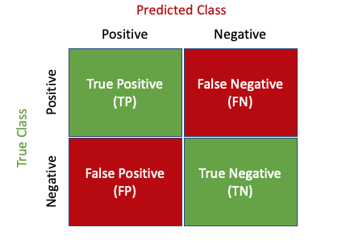
for i in range(10):
plt.figure()
plt.imshow(X_test[i])
plt.xticks([])
plt.yticks([])
plt.title(f'Actual class: {Y_test[i]}\nPredicted class: {predictions[i]}')
plt.show()

Slide 31
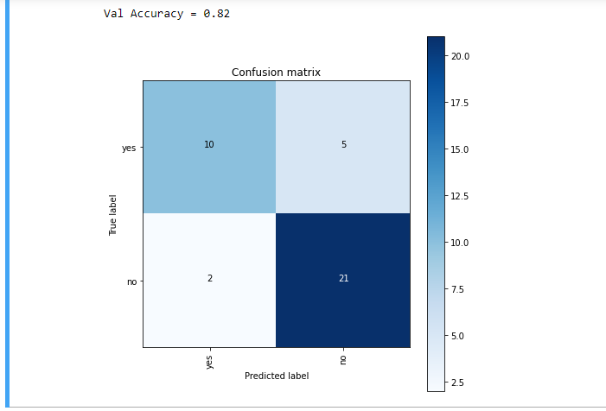
Existing System

Slide 32
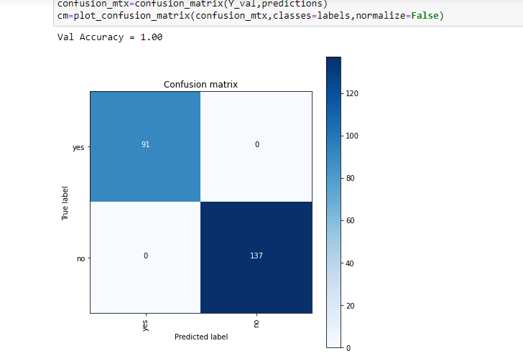
Proposed System

Slide 33
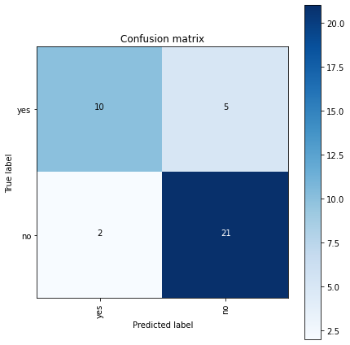
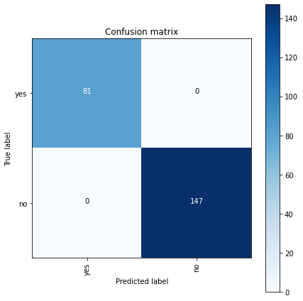
Existing System
Proposed System

Slide 35
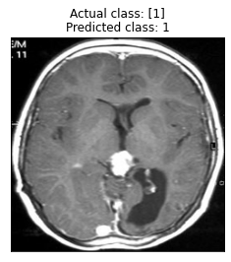
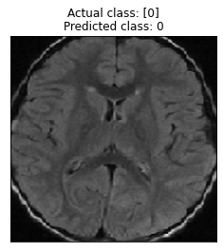
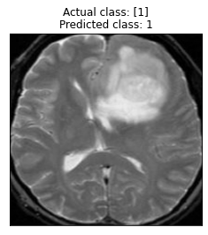
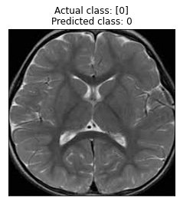
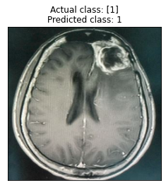
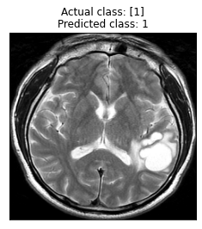

Slide 36
References:
Base Paper:
Bahadure, N. B. (2017). Image Analysis for MRI Based Brain Tumor Detection and Feature Extraction Using Biologically Inspired BWT and SVM. International Journal of Biomedical Imaging, 6- 10.
Additional References:
Aswathy, S. (2014). A survey on detection of brain tumor from MRI brain images. IEEE Xplore, 10-16.
B.V., E. (2020). Integrating uncertainty in deep neural networks for MRI based stroke analysis. ScienceDirect, 1-3.
Begum, S. S. (2020). Combining optimal wavelet statistical texture and recurrent neural network for tumour detection and classification over MRI. SpringerLink, 5-8.

